Slide 1


Slide 2
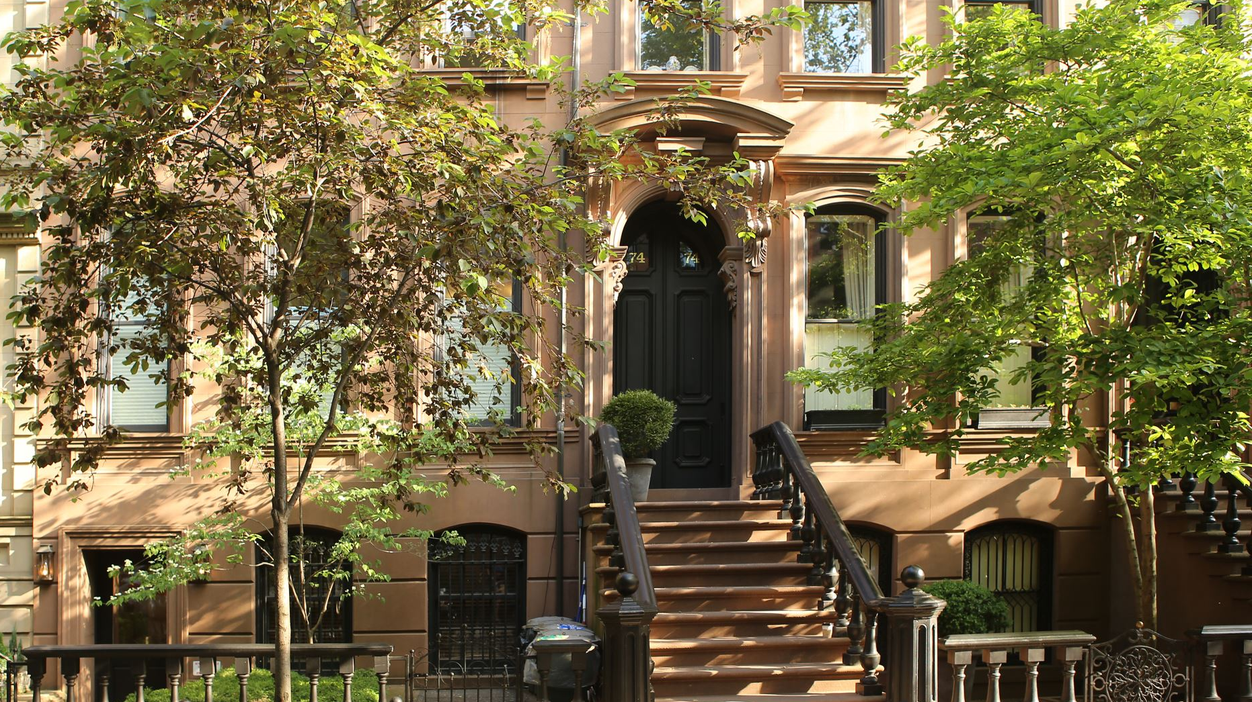
Boston house Price
Represented By:
Eng. Ziad Alsawi
www.linkedin.com/in/ziad-alsawi
Supervisor :
Dr: Doaa Mahmoud

Slide 3

Agenda
Introduction
Getting the Data and Previous Preprocess
Dataset overview
Data Exploration
Data cleaning
Modeling

Slide 4

introduction
In this project, we will develop and evaluate the performance and the predictive power of a model trained and tested on data collected from houses in Boston’s suburbs.

Slide 5

introduction
Once we get a good fit, we will use this model to predict the monetary value of a house located at the Boston’s area.

Slide 6
Getting the Data and Previous Preprocess
The dataset used in this project comes from the UCI Machine Learning Repository. This data was collected in 1978 and each of the 506 entries represents aggregate information about 14 features of homes from various suburbs located in Boston.

Slide 7
Dataset Overview The features can be summarized as follows:
CRIM: This is the per capita crime rate by town
ZN: This is the proportion of residential land zoned for lots larger than 25,000 sq.ft.
INDUS: This is the proportion of non-retail business acres per town.
CHAS: This is the Charles River dummy variable (this is equal to 1 if tract bounds river; 0 otherwise)
NOX: This is the nitric oxides concentration (parts per 10 million)
RM: This is the average number of rooms per dwelling
AGE: This is the proportion of owner-occupied units built prior to 1940
DIS: This is the weighted distances to five Boston employment centers
RAD: This is the index of accessibility to radial highways
TAX: This is the full-value property-tax rate per $10,000
PTRATIO: This is the pupil-teacher ratio by town
B: This is calculated as 1000(Bk — 0.63)², where Bk is the proportion of people of African American descent by town
LSTAT: This is the percentage lower status of the population
MEDV: This is the median value of owner-occupied homes in $1000s

Slide 8
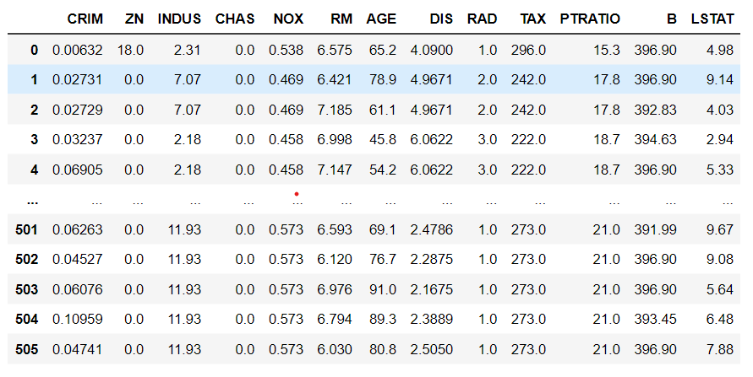
Dataset Overview This is an overview of the original dataset, with its original features:

Slide 9

Data Exploration and Analysis

Slide 10
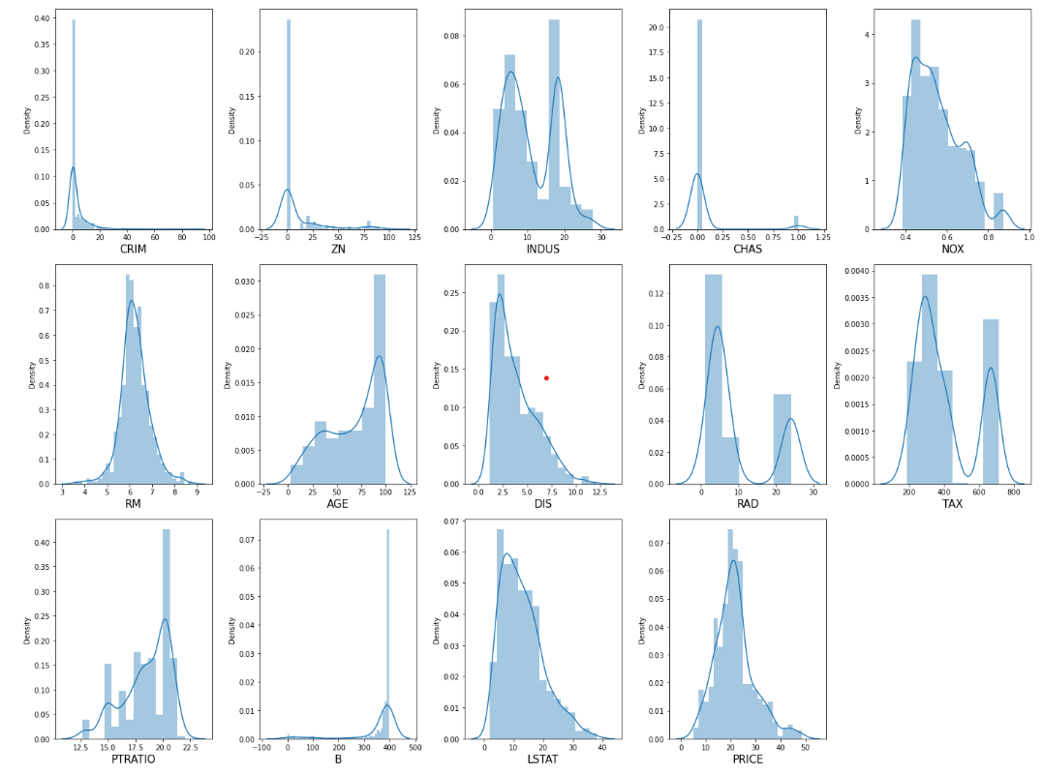
how data is distributed for every column

Slide 11
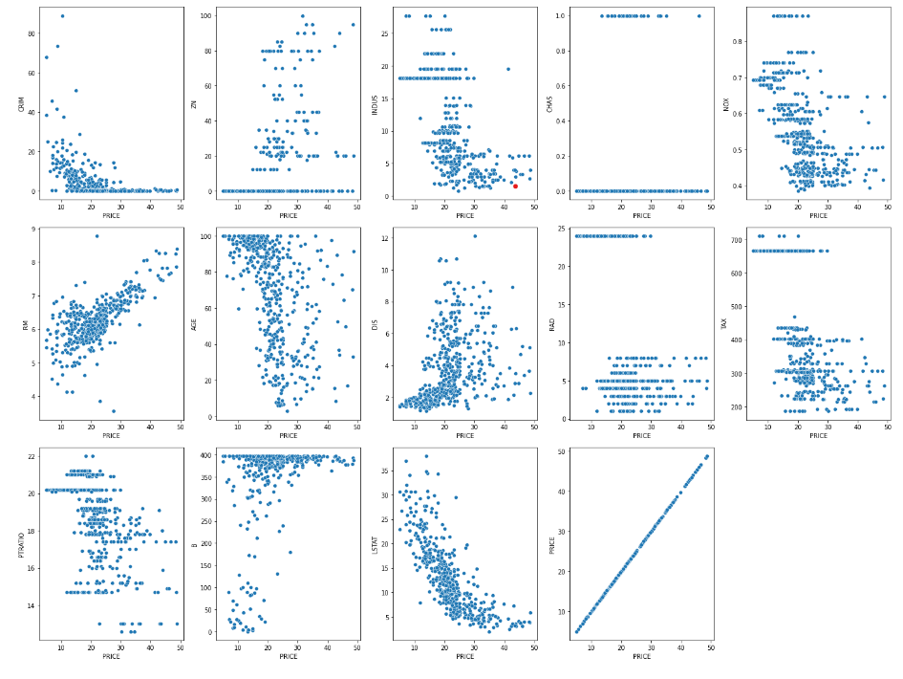

Slide 12
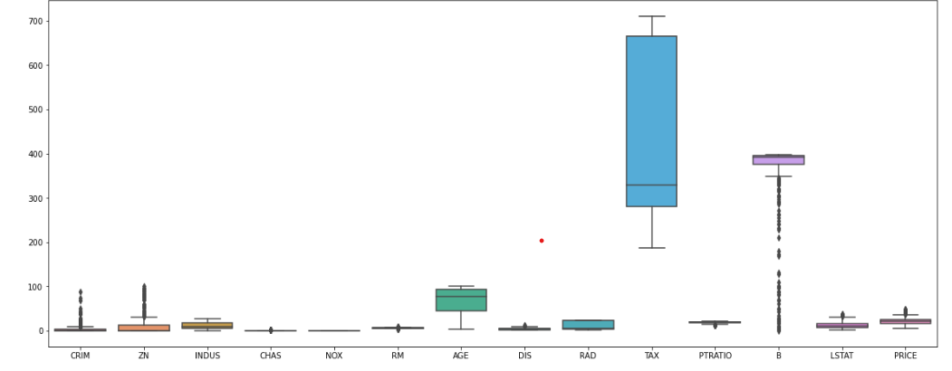

Slide 13
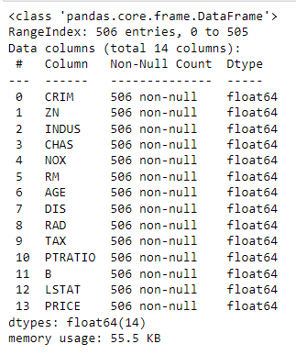
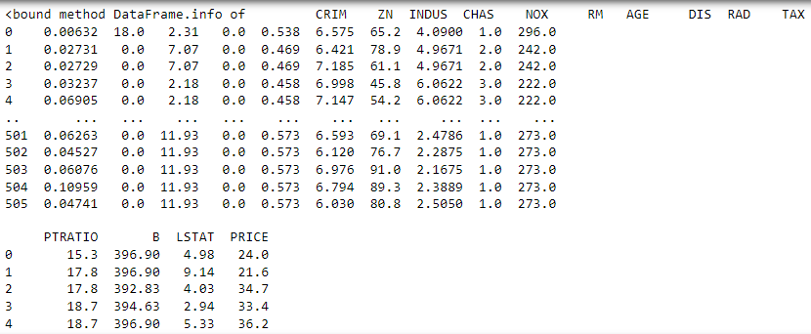
.

Slide 14
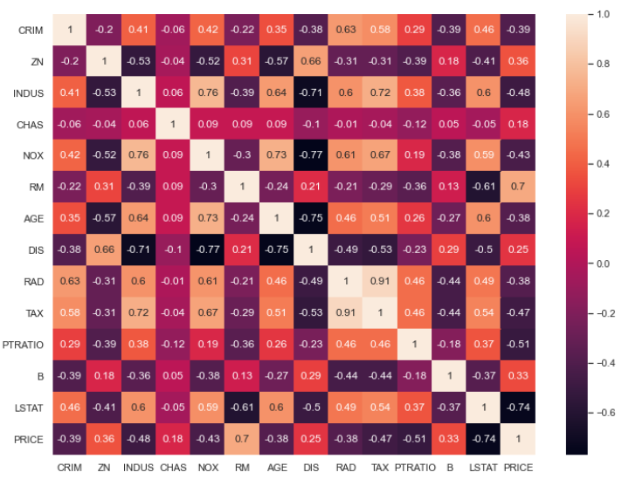
Get correlation between Price and all columns
Notes:
#RM: average number of rooms per dwelling has a high **POSITIVE** correlation with PRICE (0.7).# #LSTAT: % lower status of the population has a high **NEGATIVE** corrleation with PRICE (-0.74)
#LSTAT and RM have a fairly strong correlation between themselves too (0.61) - not ideal.

Slide 15

Data Cleaning

Slide 16
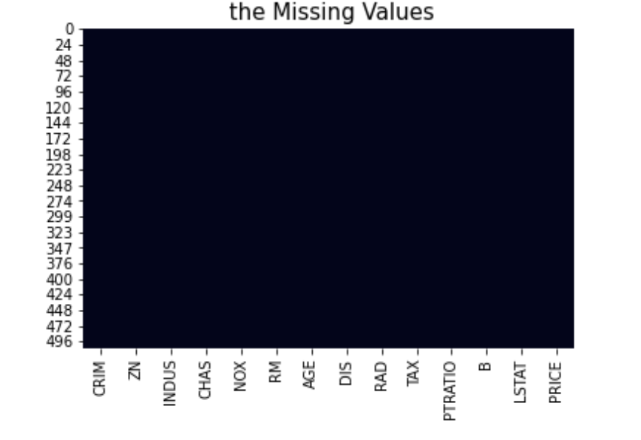
The missing values

Slide 17

Modeling

Slide 18
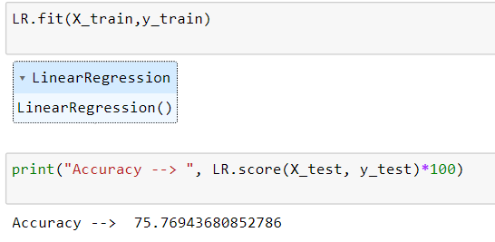
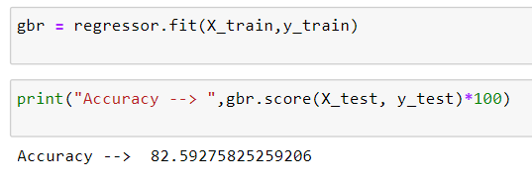
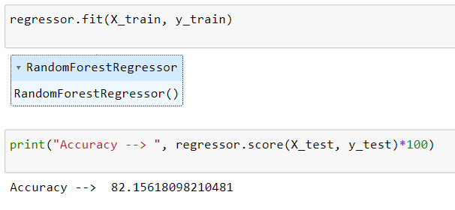
LinearRegression : 75.7 , RandomForestRegressor : 82.15 GradientBoostingRegressor : 82.5

Slide 19

.

